Slide 1
Direct to Store
Vendor Policy
2024
Weis Markets, Inc. Updated

Slide 2
Table of Contents
CONDUCT....................................................................................................................................................................2
PRIOR TO WORKING IN OUR STORES ...............................................................................................................................................2
WHILE WORKING IN OUR STORES ....................................................................................................................................................2
Be Customer Centric...........................................................................................................................................2
Shelf & Stock Conditions ....................................................................................................................................3
Shelf Tags & Stickered Product...........................................................................................................................3
Planogram Integrity ............................................................................................................................................3
Display Change Over...........................................................................................................................................3
On the Sales Floor...............................................................................................................................................3
AFTER WORKING IN OUR STORES ....................................................................................................................................................4
Back Stock...........................................................................................................................................................4
Credits.................................................................................................................................................................4
5-S Standards......................................................................................................................................................4
COMMUNICATION AT STORE LEVEL...........................................................................................................................5
DSD Service Support Process..............................................................................................................................5
DSD Service Now Process.................................................................................................................5
DRESS CODE................................................................................................................................................................6
Cell Phone Use....................................................................................................................................................6
SCAN BASED TRADING.………………...............................................................................................................................7
BACK ROOM COMPLIANCE..........................................................................................................................................9
Notes:
See Highlighted I don’t believe we are using the term 5S any longer

Slide 3
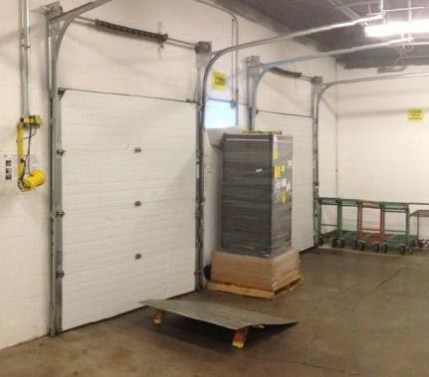
WEIS MARKETS DIRECT TO STORE VENDOR POLICY
All vendors are expected to conduct themselves in a professional manner when in our stores. In an effort to deliver an exceptional shopping experience by offering the best service, value, quality, and freshest products while being good stewards of our environment and giving back to the communities we serve, we would like to communicate our expectations regarding vendor’s proper conduct and attire when visiting and servicing our stores..
CONDUCT
PRIOR TO WORKING IN OUR STORES
Upon entering the store, always begin by signing the vendor sign-in log located in back by the receiver
Product deliveries should be made during the posted receiving hours
  We have over 110 stores that begin receiving at 4AM
The main entrance should not be used to make deliveries
A Weis associate must be present when entering or exiting the receiving door
Only authorized product is to be delivered to the store, no additions
No merchandise is to be left unattended in carts and/or trays outside the receiving doors
Product quantities should match the invoice amount
For the health and safety of children, please do not bring them with you while working in our stores
Credited Product will be held in the designated holding area (red box) . After the Vendor has finished servicing the store, the credits will be removed from the store as the Vendor exits the building
WHILE WORKING IN OUR STORES
Be Customer Centric
Be courteous. We do not tolerate foul or abusive language in our stores
If a customer asks you for help, try to do so
If you are unable to help, be polite and find an associate to assist him or her
  Do not respond “I don’t know. I don’t work here.”
  Remember, you are representing our company and yours while working in our stores
  We expect our associates to respect our vendors and in turn we expect our vendors to respect our associates
Notes:
See Highlighted - Is this accurate?

Slide 4
Shelf & Stock Conditions
We expect to be in stock 7 days a week
All stores need to be conditioned by 10AM
All displays should be filled, blocked and/or consolidated with each service
Vendors are required to rotate product at all times, at every delivery
  Outdated product on the sales floor or in back stock is not tolerated
  If an item is going to expire prior to the next delivery date, it needs to be pulled off the sales floor during the current visit
Keep the shelves sanitized
  Clean shelves and/or display areas weekly or more often if needed
  Cleaning supplies are located at receiving or customer service
Shelf conditions should be blocked and fronted with each service (This includes Top Stock)
  Top Stock policy should be followed (no more than 10lbs per item and 40lbs per 4ft section)
  Top Stock ladder should be replaced in backroom after use and never left unattended
Shelf Tags & Stickered Product
Vendors should not adjust or remove shelf tags without approval
Vendors should ensure all displays are signed before leaving the store
Vendors should communicate shelf tag discrepancies with the Pricing Accuracy Coordinator (PAC)
Correct use of promotional stickers are allowed on product
BOGO stickers or price points must state “With Club Card”
Stickers should mainly be loaded at the start of the promotion
All stickers need to be removed at the end of the promotional club period
  The product will need to be credited out if the sticker does not pull off cleanly
Planogram Integrity
We expect the planogram integrity to be maintained
Do not cover over holes on the shelves
Display Change Over
Display changeovers must occur after 6pm on Wednesday and be completed by 8am Thursday morning
Accommodate store management on special activities
On the Sales Floor
Do not leave trash on the sales floor
U-boats or appropriately sized vendor carts should be used for stocking product on the sales floor (shelves must be used on U-Boats at all times, no exceptions)
Eating and drinking on the sales floor or in the backroom is strictly prohibited
Tobacco usage is not permitted in our stores and this includes smokeless tobacco
Pallets and pallet jacks are not permitted on the sales floor between the hours of 8am-8pm.
Categories | Soda | Energy | Energy | Coffee-SB Frap | Juice/Tea-64oz | Tea-6pk | Tea-12pk
Top Stock Items | 1/2 Liters | 12oz Cans | 16oz Cans | 13.75oz | 64oz | 101.4oz | 202.8oz
Weight | 6.34 lbs | .75lb | 1 lb | .85 lb | 4 lb. | 6.34lbs | 12.7lb.
Limit per 4 ft Shelf | 7-1.75 cases | 60-5 cases | 45-3.5 cases | 53-4 cases | 11 Units | 7 units | 3 units
Notes:
See Highlighted – Is this correct?

Slide 5
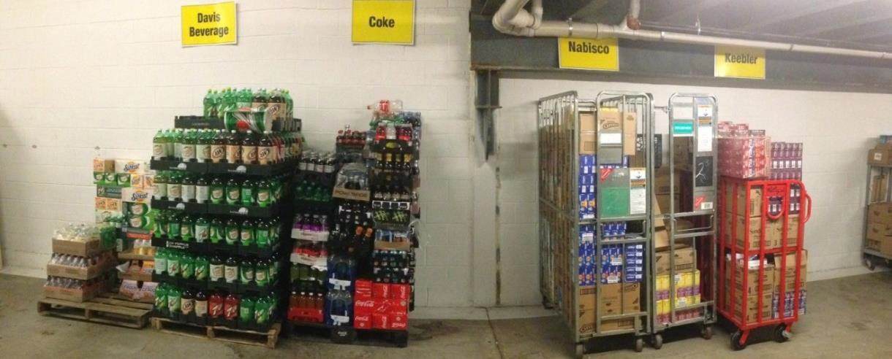
AFTER WORKING IN OUR STORES
Back Stock
Adequate stock levels must be maintained between deliveries
Excessive amounts of product are not to be stored in the back room
Vendors must maintain their back stock in an organized fashion
Stack all pallets of your product in the designated area of the backroom before leaving the store
Credits
Any distressed merchandise removed from the shelf should be taken to the backroom to be creditedout
Credit out product with every delivery
  Standards
    Keep product within defined location(s) of the back room
    Area must be kept neat, clean and organized
    Additional product needed for major sale programs can be stored in flex DSD area
    Chimney Stack sale product in back rooms for organized, easy replenishment.
    Backstock should support sales to maintain in-stock conditions until next delivery
    Communicate with store management team on agreed upon backstock levels
    Vendors should follow the Blue Chip Process for overstock product
    Shopping carts should not be used to store or service product
COMMUNICATION AT STORE LEVEL
We ask that you build relationships with store managers and the management team. Share sales and trend numbers. We want you to utilize data to help drive sales making decisions.
At minimum, meet or exceed agreed upon store merchandising delivery schedules
Merchandising and delivery schedules need to be adjusted based on store volume and approved by Category Management team
Accommodate store management on special activities
Meet with the store management team weekly to plan displays to support weekly ads and promotions
When possible check in with a member of Weis management team during each visit
Notes:
See Highlighted – Remove When Possible

Slide 6
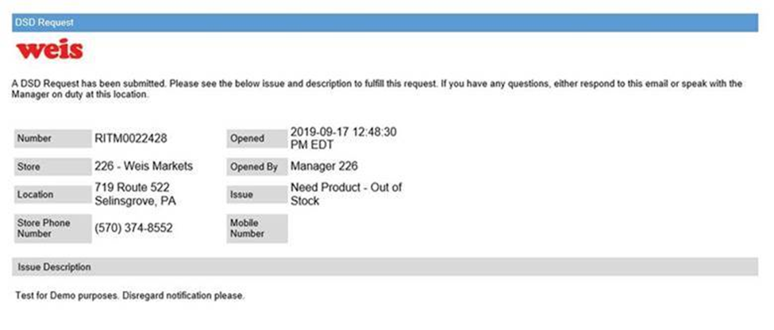
SERVICE ISSUES AND RESOLUTION THROUGH SERVICE NOW
Weis has implemented a new DSD communications called Service Now.
Below is a screen shot of the entry page our STORES will utilize when a service call is necessary.
The store will enter key service-related information and picture of the issue. An automated e-mail will go out to 3 key contacts for the store.
Store Rep, Sales Person, IO, etc.
Area manager, Depot Manager, Route supervisor
Key Account mgr.
Expectation is that the service issue is resolved with in 4 hours of first e mail notice. (shelf or store condition in picture must be corrected to close an issue. Simply contacting store is not resolution)
Escalation in four-hour increments unless request is closed by Weis associate (vendors cannot close requests)
If the issue remains unresolved the service call will continue to be sent every 4 hours to all of the vendor store contacts. Additionally it will be escalated to increased levels of Weis Senior team .
Resolution of a request means corrective action in store has been completed i.e. (holes filled, service completed, product delivered, back room corrected to standards). An acknowledgement or comment back to store is not resolution! We encourage the communication to keep store informed on request status. Expected resolution is within 4 hours of the reported issue unless reported after 4 pm and then expectation is by 10 am next day.
Vendors will NOT see or have any involvement with the log-in process-they simply need to respond to the e-mail.
The screen shot is provided here merely as an overview for your understanding of the new process.
Service requests automatically emailed to:
3 levels of vendor supervision specific to the store
cc to Weis CM, Director, VP
cc to Store Contact
Reporting available per vendor, per store over time to track improvement or deterioration of service

Slide 7

DRESS CODE
Proper dress attire is required at all times. Generally, associates should always be clean and well-groomed when working in one of our stores. No torn clothes, open-toed shoes, or inappropriate logos are accepted. We expect vendors and all other associates working in our stores to be present a professional image at all times, which
includes wearing a name badge with your company’s’ name or a company uniform. We have crafted a clear-cut dress code policy that should be minded when working in our stores.
 | Acceptable | Unacceptable
Shirts | Polo Shirts Blouse or shirts with sleeves Shirts/Blouses must cover midriff areas Sweaters and Cardigans Company issued uniforms | T-Shirts Sweatshirts Tank Tops Spaghetti Strap Shirts Shirts or Sweaters displaying inappropriate writing or images that are not company or product related
Slacks or Skirts | Casual Slacks worn around the waist, not low on the hips Company “Uniform” Shorts Only Jeans that are clean and in good shape (If your company allows them) | Sweat Pants/ Exercise Wear Shorts: Tight Fitting, Cutoff or Baggy Shorts (no shorter than 3 inches above the knee)
Shoes | Boating or Deck Shoes Casual or Low Heel Shoes (Closed Toed) Steel Toed Shoes and Athletic Shoes Loafers and Dress Shoes | Flip Flops Open-Toed Shoes
Cell Phone Use
Keep cell phones on vibrate within the store
Use of cell phones on the sales floor for personal use is strictly prohibited
O Phone use is ONLY acceptable when it is required to conduct business
The use of cell phones when transporting product on the sales floor is also prohibited
The use of ear buds and blue-tooth devices are prohibited

Slide 8


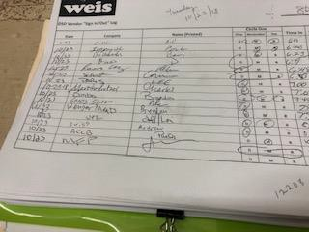


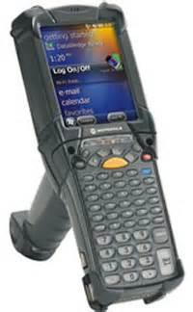


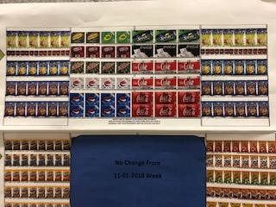
 | Scan Based Trading Receiving Procedures
Department | All Center Store Departments
Benefits: • Provide adequate DSD stock level Reduce lost revenue and improved efficiencies
Vendor Sign in Vendors will come through the receiving door Vendors will sign in the book per guidelines Vendors must check in with the BCA when arriving to the store *Note: Vendors will adhere to the current receiving hours*
Process Credits Credits will not be entered into the system as they are based on scan data Merchandise must be removed from company premises by the vendor The BCA will verify product removal before the the vendor exits BCA will perform weekly code checks to verify SBT vendor rotation standards
Process New Deliveries BCA will verify the product coming in but will not scan the product in
Vendor Responsibilities Adhere to Weis Markets plan-o-gram Reporting improper tagging and signage to management Current rotation and removal of out- dated product standards
Page 1 of 2 SBT Receiving Procedures Rev. 9/20/2019

Slide 9


 | Scan Based Trading Receiving Procedures
Department | All Center Store Departments
Benefits: • Provide adequate DSD stock level Reduce lost revenue and improved efficiencies
Additional Notes Scan-based trading (SBT) is the process where suppliers maintain ownership of inventory within retailers’ warehouses or stores until items are scanned at the point of sale The company we are working with to manager SBT is called the Park City Group Because we do not own the product store to store and department to department transfers for items on SBT are not authorized
Page 2 of 2 SBT Receiving Procedures Rev. 9/20/2019

Slide 10

Backroom Compliance Associate
Vendor Violations & Discrepancies
If a Vendor violates any of the following, the violation must be documented on the Vendor Discrepancy / Violation Log.
If a Vendor violates any of the following three or more times in eight weeks, a Vendor Discrepancy Notice should be sent to the specific Vendor Contact, via email.
 | Violation
1) | Failure to Sign In/Out or failure to circle Vendor Position.
2) | Credits not processed first.
3) | Wrong quantities on invoice.
4) | Placing cardboard or product in the Baler, Compactor, or Dumpster.
5) | Entering or exiting the Receiving Door without the BCA Associate or Store Management present.
6) | Leaving Out of Date product on the sales floor or in the Vendor Backstock Area.
7) | Delivering before or after Receiving hours without authorization.
8) | Delivering unauthorized product.
9) | Failure to maintain Vendor Backstock Area.
10) | Leaving merchandise, carts, or trays outside of the Receiving Area.
11) | Failure to maintain adequate stock levels between deliveries.
12) | Maintaining excessive amount of product in the Stockroom or Vendor Return Area.
13) | Lack of co-operation with the BCA Associate and/or Store Management.
14) | Entering through the Main entrance to check the shelf for credits.
15) | Providing associates with free merchandise.
Asset Protection October 2018

